Slide 1
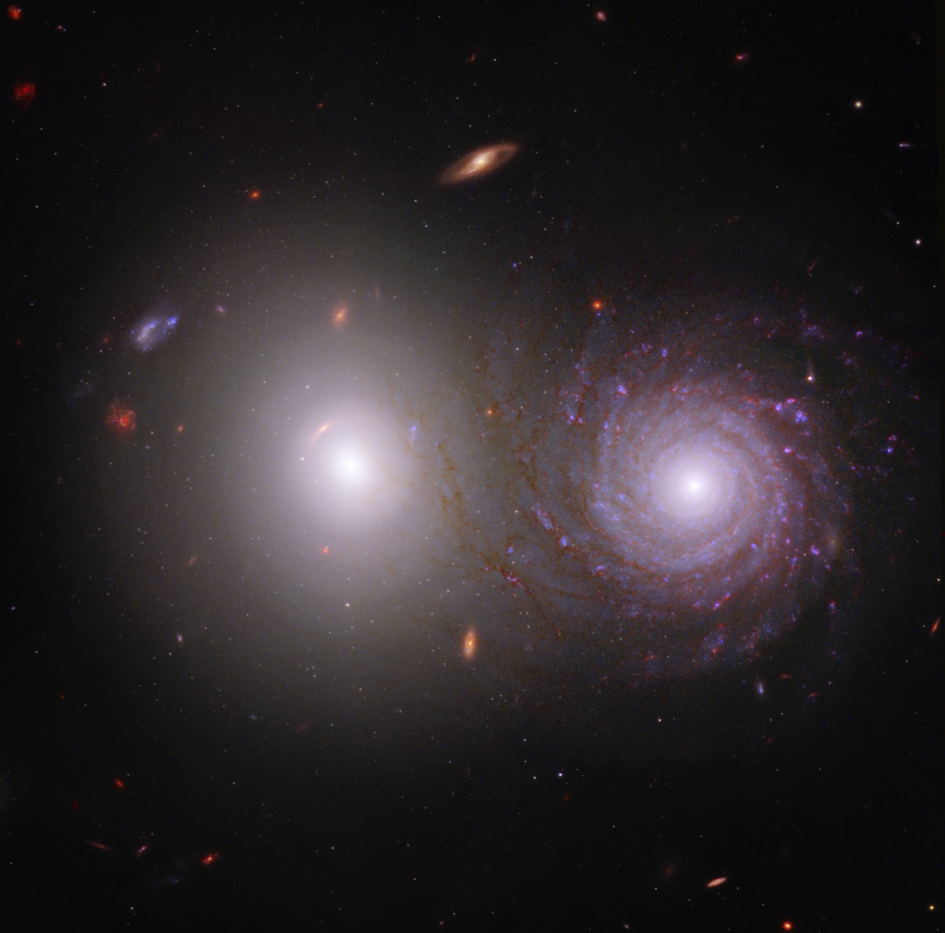
Globular Cluster SEDs of Galaxy Pair VV191
Ashton Cardona
Dr. Rogier Windhorst, Dr. Timothy Carleton
Arizona State University, NASA Space Grant
Notes:
Test notes

Slide 2
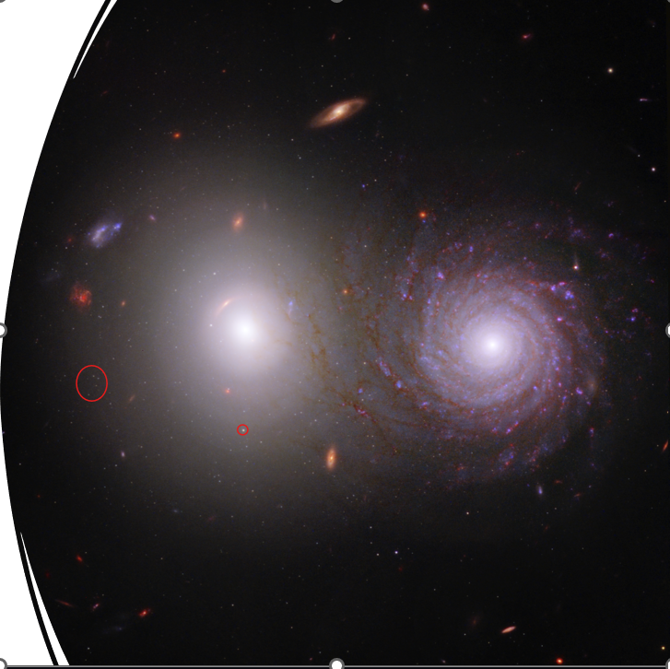
Goals
Create SEDs for the globular clusters in the elliptical galaxy in VV191
Use fitted data from these to infer how the galaxy evolved over time

Slide 3
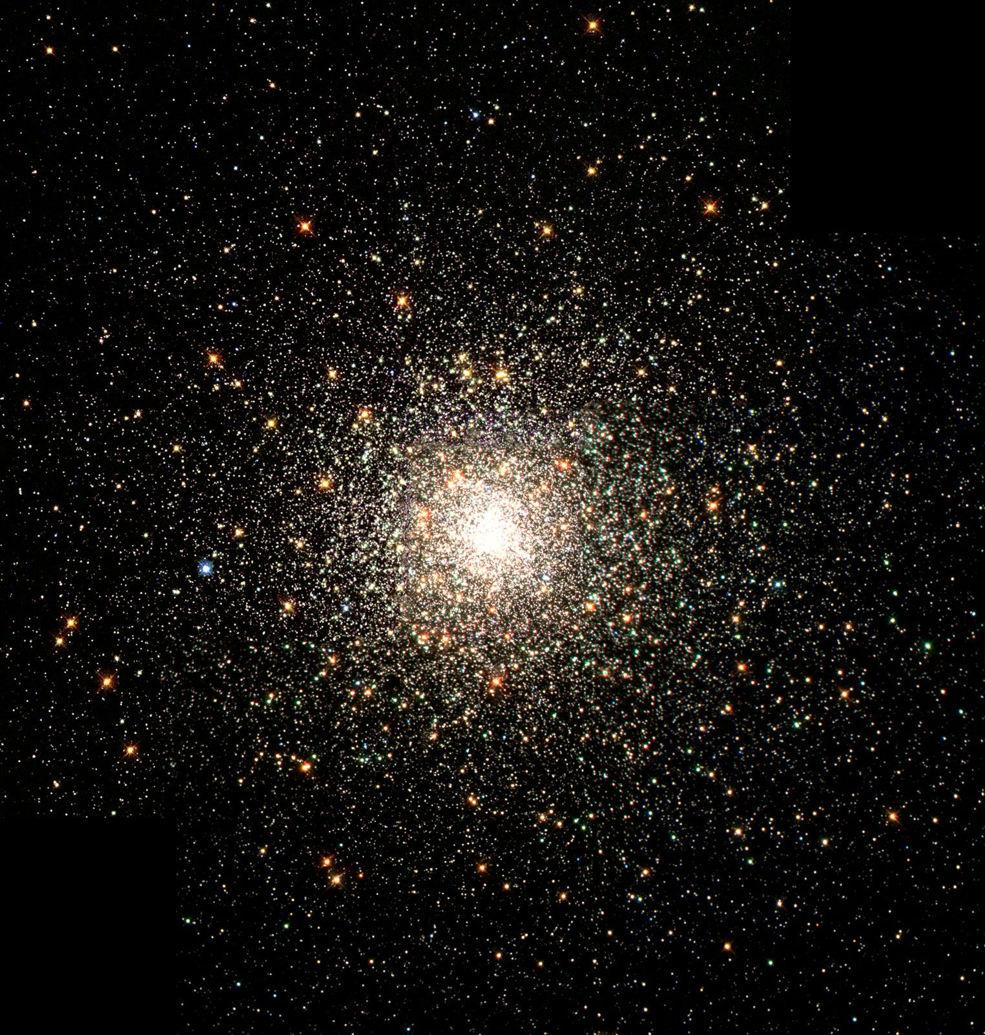
What are Globular Clusters (GCs)?
Older Star clusters (“Red and Dead”)
Not all the same age within a galaxy
Can give records on how a galaxy evolved over time (“Fossil Records”)

Slide 4
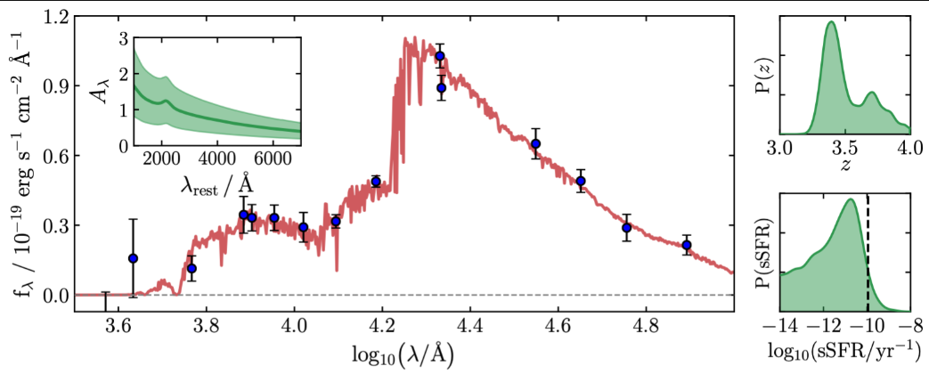
What are SEDs?
Spectral Emission Distribution
Can be Photometric or Spectroscopic
Can obtain fitted parameters using known photometric data

Slide 5
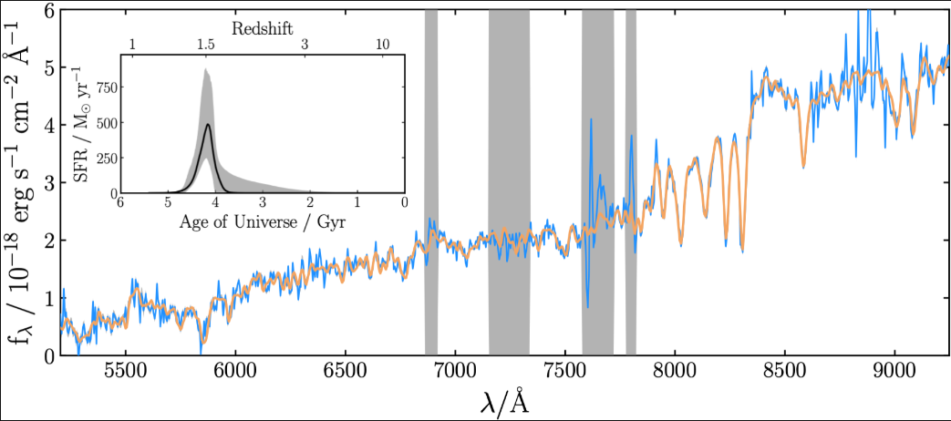
How the SED Gets Made
Created via photometry (measuring the brightness of the object)
Python Package (Bagpipes) fits the created data set
Utilizes given parameters with a sampler to perform fit
4 JWST filters, 1 Hubble filter

Slide 6
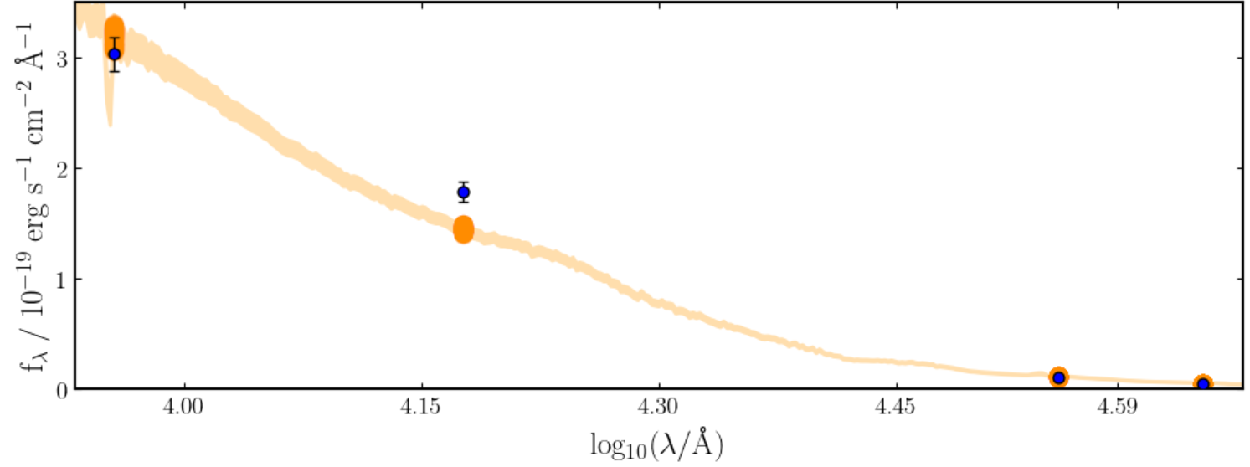
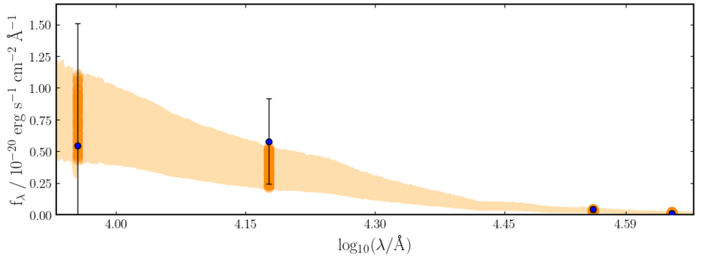
Results
Overall SEDs are showing promise (orange line is ending up inside error bars on most fits that have been run)
Preliminary data is not completely lining up with fitted data (orange line end up outside blue points’ error range), suggesting something off with either data or models

Slide 7
Conclusions
Able to determine GC characteristics within galaxy
Refine data/models in order to obtain better fitted data to properly study the elliptical’s evolution

Slide 8

Acknowledgements/Questions?
Thank you to Rogier Windhorst, Tim Carleton, and NASA Space Grant
Additional questions?
Email: ancardo3@asu.edu

